Slide 1
Neural Networks and Deep learning

Slide 2
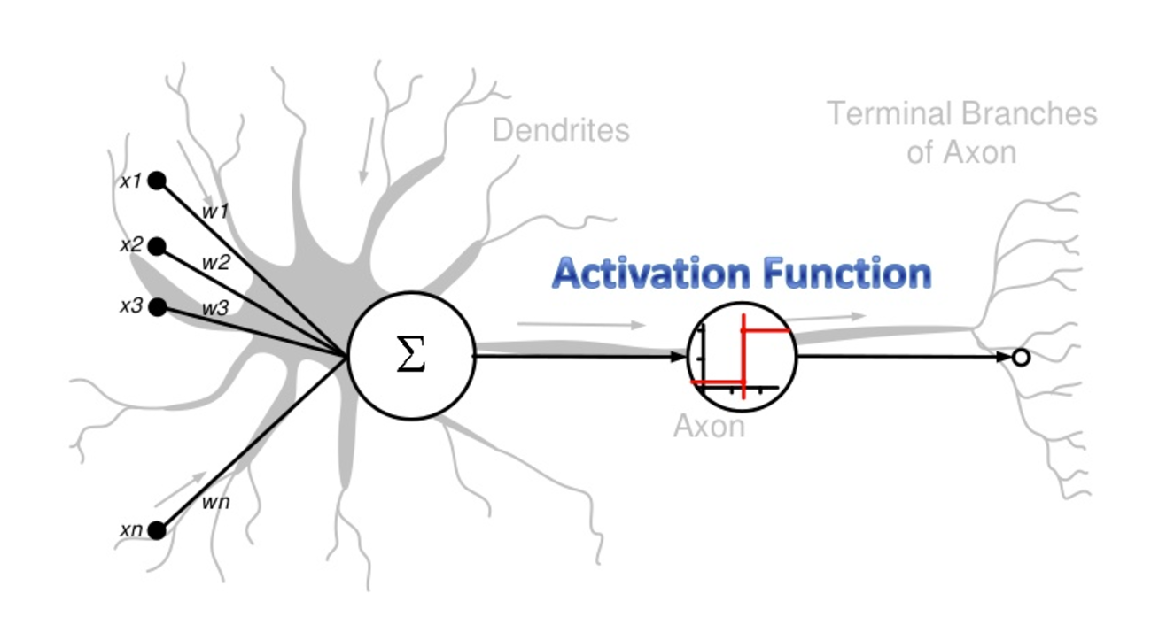
Neural Network for Classification
Started by psychologists and neurobiologists to develop and test computational analogues of neurons
A neural network: A set of connected input/output units where each connection has a weight associated with it
During the learning phase, the network learns by adjusting the weights so as to be able to predict the correct class label of the input tuples
Artificial Neural Networks as an analogy of Biological Neural Networks

Slide 3

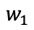
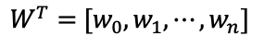
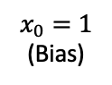
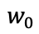
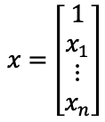

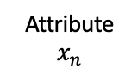
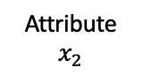
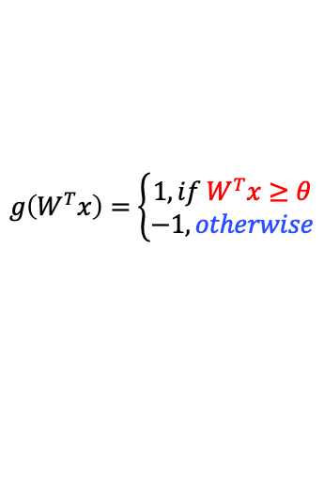
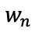
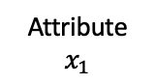
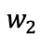
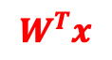
Perceptron: Predecessor of a Neural Network
A perceptron is a neuron, and connects its inputs to the output
Output Label: -1/1
Step Function
$$g\left(W^{T}x\right)=\left\{\begin{matrix}1, if{ W}^{T}x≥θ \\ −1, otherwise\end{matrix}\right.$$
Weighted Sum
$$W^{T}x$$
Measure of importance
$$w_{0}$$
$$w_{1}$$
$$w_{n}$$
$$W^{T}=[w_{0},w_{1},⋯,w_{n}]$$
$$w_{2}$$
$$x=\left[\begin{matrix}1 \\ x_{1} \\ \begin{aligned}⋮ \\ x_{n}\end{aligned}\end{matrix}\right]$$
Input Layer
$$x_{0}=1$$
(Bias)
Attribute
$$x_{1}$$
Attribute
$$x_{2}$$
$$⋯$$
Attribute
$$x_{n}$$
Invented in 1957 by Frank Rosenblatt. The original perceptron model does not have a non-linear activation function

Slide 4
Perceptrons
Very intuitive, and easy to implement.
A good entry point to the (re-discovered) modern state-of-the-art machine learning algorithms: deep learning.

Slide 5
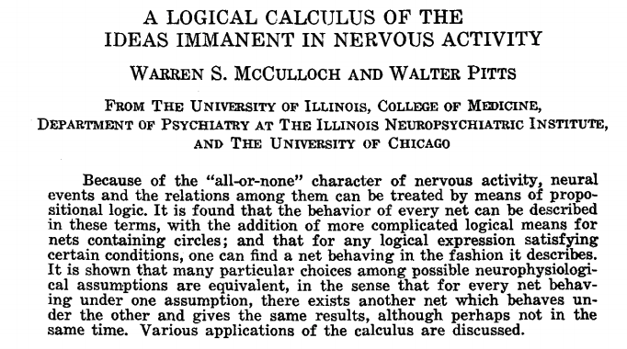
Artificial Neurons and the McCulloch-Pitts Model
The initial idea of the perceptron dates back to the work of Warren McCulloch and Walter Pitts in 1943
Drew an analogy between biological neurons and simple logic gates with binary outputs

Slide 6
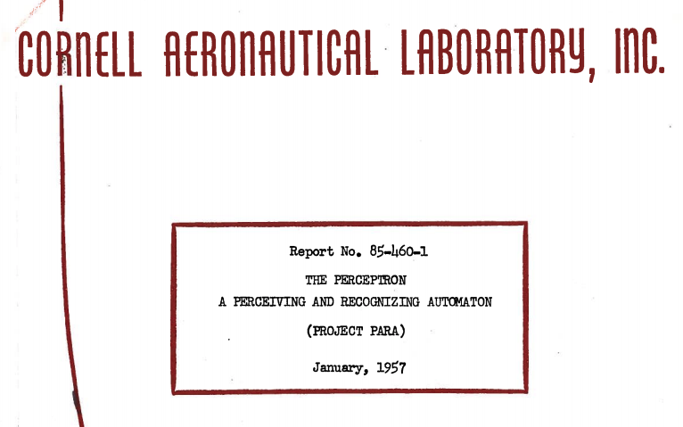
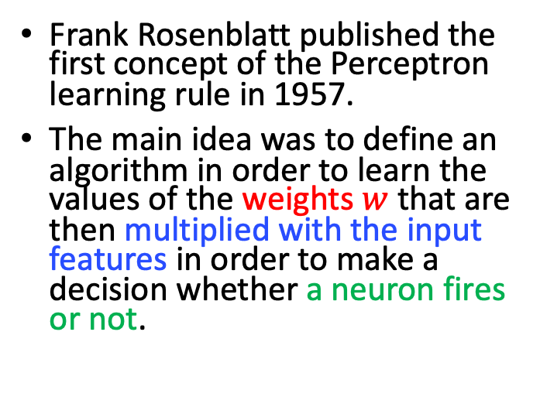
Frank Rosenblatt’s Perceptron
Frank Rosenblatt published the first concept of the Perceptron learning rule in 1957.
The main idea was to define an algorithm in order to learn the values of the weights $w$ that are then multiplied with the input features in order to make a decision whether a neuron fires or not.
https://blogs.umass.edu/brain-wars/files/2016/03/rosenblatt-1957.pdf

Slide 7
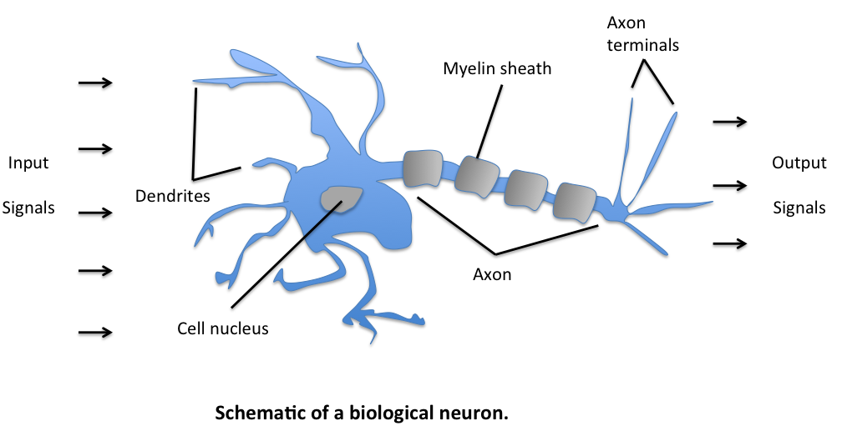

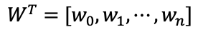


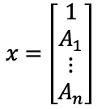

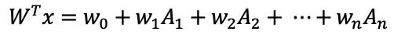
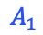
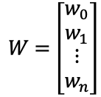
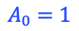
Perceptron
$$x=\left[\begin{matrix}1 \\ A_{1} \\ \begin{aligned}⋮ \\ A_{n}\end{aligned}\end{matrix}\right]$$
Data
Weights:
Accumulation
The signals of variable magnitudes arrive at the dendrites.
$$A_{0}=1$$
$$A_{1}$$
$$w_{1}$$
$$w_{0}$$
$$W^{T}x$$
$$W=\left[\begin{matrix}w_{0} \\ w_{1} \\ \begin{aligned}⋮ \\ w_{n}\end{aligned}\end{matrix}\right]$$
$$W^{T}=[w_{0},w_{1},⋯,w_{n}]$$
Learn the values of the weights $w$ that are then multiplied with the input features
Those input signals are then accumulated in the cell body of the neuron.
$$W^{T}x=w_{0}+w_{1}A_{1}+w_{2}A_{2}+ ⋯+w_{n}A_{n}$$

Slide 8
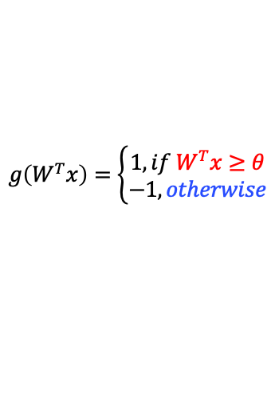
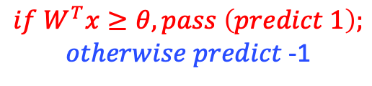
Perceptron
If the accumulated signal exceeds a certain threshold, a output signal is generated that will be passed on by the axon.
$$A_{0}=1$$
$$A_{1}$$
$$w_{1}$$
$$w_{0}$$
$$W^{T}x$$
$$if W^{T}x≥θ, pass \left(predict 1\right);$$
$otherwise predict$ -1
$$g\left(W^{T}x\right)=\left\{\begin{matrix}1, if{ W}^{T}x≥θ \\ −1, otherwise\end{matrix}\right.$$
activation function

Slide 9
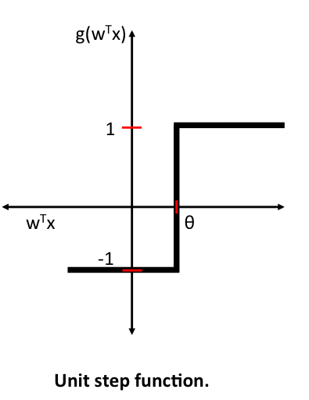

Activation Function
Unit Step Function
Sigmoid Function
$$g\left(W^{T}x\right)=\left\{\begin{matrix}1, if{ W}^{T}x≥θ \\ −1, otherwise\end{matrix}\right.$$

Slide 10
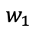
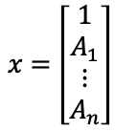
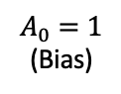
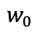
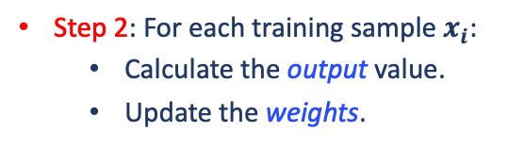


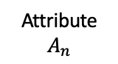
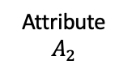
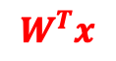
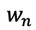
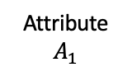
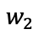
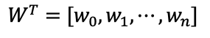
The Perceptron Learning Rule
Output Label: -1/1
Step 2: For each training sample $x_{i}$:
Calculate the output value.
Update the weights.
Step Function
$$g\left(W^{T}x\right)=\left\{\begin{matrix}1, if{ W}^{T}x≥θ \\ −1, otherwise\end{matrix}\right.$$
Weighted Sum
$$W^{T}x$$
Measure of importance
Step 1: Initialize the weights to small random numbers.
$$w_{0}$$
$$w_{1}$$
$$w_{n}$$
$$W^{T}=[w_{0},w_{1},⋯,w_{n}]$$
$$w_{2}$$
$$x=\left[\begin{matrix}1 \\ A_{1} \\ \begin{aligned}⋮ \\ A_{n}\end{aligned}\end{matrix}\right]$$
Input Layer
$$A_{0}=1$$
(Bias)
Attribute
$$A_{1}$$
Attribute
$$A_{2}$$
$$⋯$$
Attribute
$$A_{n}$$

Slide 11
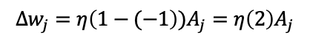
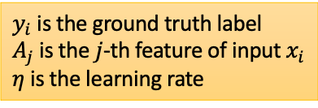
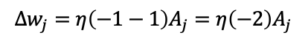
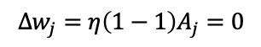
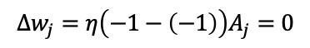
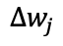
The Perceptron Learning Rule
The output value is the class label predicted by the unit step function: $g\left(W^{T}x\right)$
The weight update can be written more formally as
$$w_{j}^{(t+1)}=w_{j}^{(t)}−η\left(y_{i}−g\left(W^{T}x\right)\right)\left(−A_{j}\right)$$
$=w_{j}^{\left(t\right)}+η\left(y_{i}−g\left(W^{T}x\right)\right)A_{j}$
The value of $∆w_{j}$
$y_{i}$ is the ground truth label
$A_{j}$ is the $j$-th feature of input $x_{i}$
$η$ is the learning rate
$$∆w_{j}$$
$$∆w_{j}=η\left(−1−\left(−1\right)\right)A_{j}=0$$
$$∆w_{j}=η\left(1−1\right)A_{j}=0$$
$$∆w_{j}=η\left(−1−1\right)A_{j}=η\left(−2\right)A_{j}$$
$$∆w_{j}=η\left(1−(−1\right))A_{j}=η\left(2\right)A_{j}$$

Slide 12
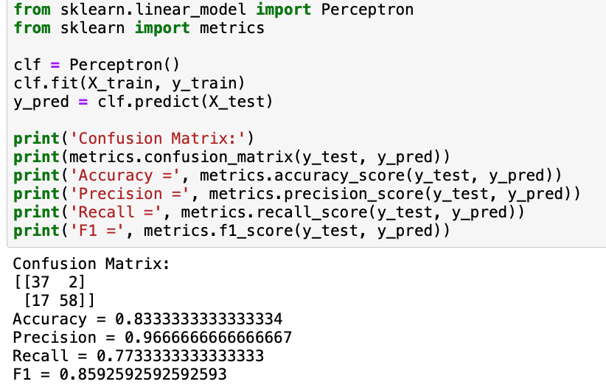
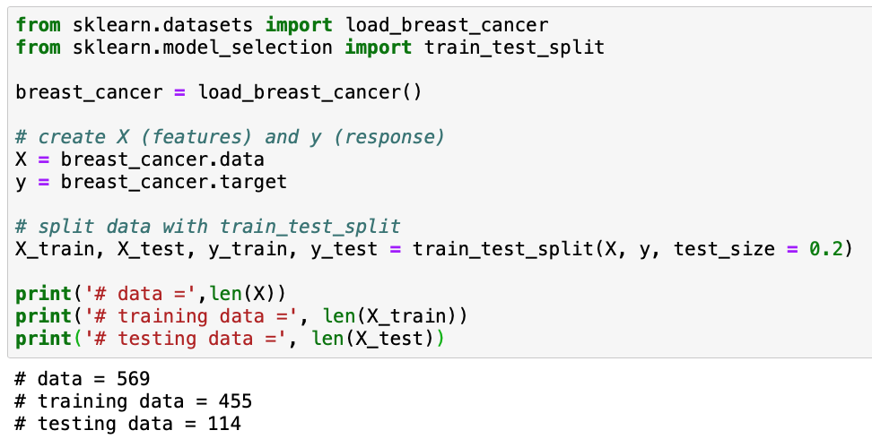
Sample Code

Slide 13
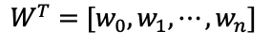
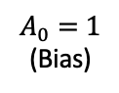
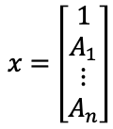
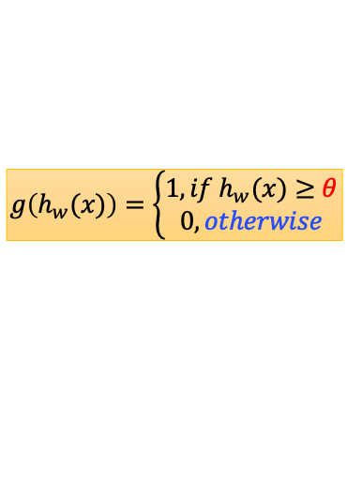







Perceptron v.s. Logistic Regression
Output Label: -1/1
Output Label: 0/1
$$g\left(h_{w}(x)\right)=\left\{\begin{matrix}1, if{ h}_{w}(x)≥θ \\ 0, otherwise\end{matrix}\right.$$
Step Function
$$g\left(W^{T}x\right)=\left\{\begin{matrix}1, if{ W}^{T}x≥θ \\ −1, otherwise\end{matrix}\right.$$
$$h_{w}\left(x\right)=\frac{1}{1+e^{−W^{T}x}}$$
Weighted Sum
$$W^{T}x$$
$$w_{0}$$
$$w_{1}$$
$$w_{n}$$
$$W^{T}=[w_{0},w_{1},⋯,w_{n}]$$
$$w_{2}$$
$$x=\left[\begin{matrix}1 \\ A_{1} \\ \begin{aligned}⋮ \\ A_{n}\end{aligned}\end{matrix}\right]$$
Input Layer
$$A_{0}=1$$
(Bias)
Attribute
$$A_{1}$$
Attribute
$$A_{2}$$
$$⋯$$
Attribute
$$A_{n}$$

Slide 14
Problems with Perceptrons
Cannot handle non-linear data
Not differentiable
Only work for binary classification problem
numeric output
multiple outputs

Slide 15


Multi Layered Perceptrons (MLP)
Generalizing to Multiple Labels
Distinguishing between multiple categories
Solution: Add another layer - Multi Layer Neural Networks

Slide 16

Multi Layered Perceptrons (MLP)
Multi-class classification is more applicable than binary classification
To handle non-linear data
Smooth, differentiable threshold function
unit step function
linear function
Sigmoid function

Slide 17

Neural Network Optimization
Feed Forward Neural Networks
Error Backpropagation

Slide 18
Feed Forward Neural Networks
Information only flows in one direction (forward)
Each hidden node “collects” the inputs from all input nodes and computes a weighted sum of the inputs and then applies the sigmoid function to the weighted sum.
The output of each hidden node is forwarded to every output node.
The output node “collects” the inputs (from hidden layer nodes) and computes a weighted sum of its inputs and then applies the sigmoid function to obtain the final output.
The class corresponding to the output node with the largest output value is assigned as the predicted class for the input.

Slide 19



Backpropagation
Assume that the network structure is predetermined (number of hidden nodes and interconnections)
Objective function for $n$training examples with $k$ categories:
$$L=\sum_{i=1}^{n}{\sum_{l=1}^{k}{{\left(y_{il}−o_{il}\right)}^{2}}}$$
$$y_{il}−\text{Target} \text{value} \text{associated} \text{with} \text{the} l\text{−}\text{th} \text{class} \text{for} \text{input}\text{ (}x_{i}\text{) }$$
$y_{il}=1$ when $l$ is true class for $x_{i}$, and 0 otherwise
$$o_{il}−\text{Predicted} \text{value} \text{associated} \text{with} \text{the} l\text{−}\text{th} \text{class} \text{for} \text{input}\text{ (}x_{i}\text{) }$$
Initialize all weights to small values
For each training example, ⟨x, y⟩:
Propagate input forward through the network
Propagate errors backward through the network
Gradient Descent

Slide 20
Multiple Output Perceptron
Because all inputs are densely connected to all outputs, these are called Dense layer.
$$x_{1}$$
$$z_{1}$$
$$y_{1}=g(z_{1})$$
$$x_{2}$$
$$g is a nonlinear function.$$
$$y_{2}=g(z_{2})$$
…
$$z_{2}$$
$$x_{m}$$
$$z_{i}=\sum_{j=1}^{m}{w_{j,i}x_{j}}$$

Slide 21
Single Layer Neural Network
$$z_{1}$$
$$x_{1}$$
$$x_{2}$$
$$z_{2}$$
$${\hat{y}}_{1}$$
…
$$z_{3}$$
$${\hat{y}}_{2}$$
$$x_{m}$$
…
$$z_{n}$$
Inputs
Hidden
Final Output

Slide 22
Two-Layer Neural Network
$$z_{1}$$
$$h_{1}$$
$$x_{1}$$
$$z_{2}$$
$$h_{2}$$
$${\hat{y}}_{1}$$
$$x_{2}$$
…
$$z_{3}$$
$$h_{3}$$
$${\hat{y}}_{2}$$
…
$$x_{m}$$
…
$$z_{n}$$
$$h_{s}$$
Inputs
Hidden 1
Hidden 2
Final Output

Slide 23
Deep Neural Network
…
$$z_{1}$$
$$h_{1}$$
$$x_{1}$$
…
$$z_{2}$$
$$h_{2}$$
$${\hat{y}}_{1}$$
$$x_{2}$$
Fully-connected neural network
…
…
$$z_{3}$$
$$h_{3}$$
$${\hat{y}}_{2}$$
…
$$x_{m}$$
…
…
$$z_{n}$$
$$h_{s}$$
Inputs
Hidden 1
Hidden K
Final Output

Slide 24

Deep Neural Network
Parameters (Model)
$$z_{j}=\sum_{k=1}^{m}{W_{k}^{x}x_{k}}$$
$$h_{i}=\sum_{j=1}^{n}{W_{j}^{z}z_{j}}$$
$$\hat{y}=\sum_{i=1}^{s}{W_{i}^{y}h_{i}}=\sum_{i=1}^{s}{W_{i}^{y}\sum_{j=1}^{n}{W_{j}^{z}z_{j}}}=\sum_{i=1}^{s}{W_{i}^{y}\sum_{j=1}^{n}{W_{j}^{z}\sum_{k=1}^{m}{W_{k}^{x}x_{k}}}}$$
Gradient Descent
…
$$z_{1}$$
$$h_{1}$$
$$x_{1}$$
…
$$loss(y,\hat{y})$$
$$z_{2}$$
$$h_{2}$$
$$x_{2}$$
Fully-connected neural network
…
$$\hat{y}$$
…
$$z_{3}$$
$$h_{3}$$
$$\hat{y}=\sum_{i=1}^{s}{W_{i}^{y}h_{i}}$$
…
Features
$$x_{m}$$
…
$$W^{z}∈R^{s×n}$$
…
$$W^{y}∈R^{s}$$
If m = 36, n= 128, s = 64
# parameters = n*m + s*n + s = 12,864
$$z_{n}$$
$$h_{s}$$
Discard the spatial information in images!
$$W^{x}∈R^{n×m}$$
Inputs
Hidden 1
Hidden K
Final Output

Slide 25
Three Steps for Deep Learning
Step 1: define a set of function
Step 2: goodness of function
Step 3: pick the best function
Neural
Network
Loss Function
Gradient Descent

